Slide 1
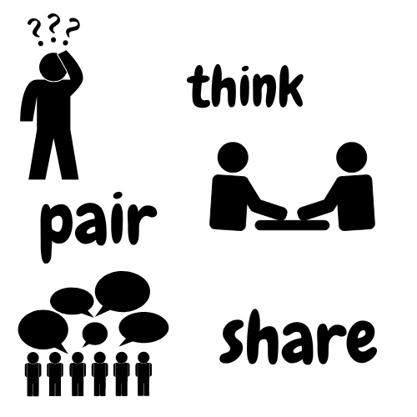

Slide 2
Debate/critical thinkers
1st Method :
Think-Pair-Share Activity
Students will be placed into small groups to answer
the following questions,
a) what is critical thinking,
b) what is an example of critical thinking?
c) give an example of a recent event where you applied critical thinking?

Slide 3
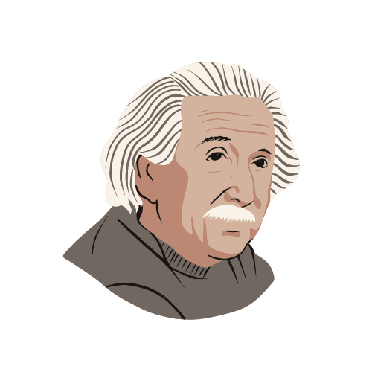
Debate/critical thinkers
1st Method :
A quote by Albert Einstein will be read to the class to help add context to importance of critical thinking
"The important thing is not to stop questioning. Curiosity has its own reason for existing."—Albert Einstein
—From the memoirs of William Miller, an editor, quoted in Life magazine, May 2, 1955; Expanded, p. 281

Slide 4
Debate/critical thinkers
1st Method :
Critical thinking defined.
“Critical thinking is the intellectually disciplined process of actively and skillfully conceptualizing, applying, analyzing, synthesizing, and/or evaluating information gathered from, or generated by, observation, experience, reflection, reasoning, or communication, as a guide to belief and action. In its exemplary form, it is based on universal intellectual values that transcend subject matter divisions: clarity, accuracy, precision, consistency, relevance, sound evidence, good reasons, depth, breadth, and fairness.
It entails the examination of those structures or elements of thought implicit in all reasoning: purpose, problem, or question-at-issue; assumptions; concepts; empirical grounding; reasoning leading to conclusions; implications and consequences; objections from alternative viewpoints; and frame of reference. Critical thinking — in being responsive to variable subject matter, issues, and purposes — is incorporated in a family of interwoven modes of thinking, among them: scientific thinking, mathematical thinking, historical thinking, anthropological thinking, economic thinking, moral thinking, and philosophical thinking.”
(Critical Thinking as Defined by the National Council for Excellence in Critical Thinking, 1987)

Slide 5
Thank You

