Slide 2
Study Cases/critical thinkers
2nd Method :
Definition:
CASE STUDY
What is the Case Study?
• Case Study: case study, case analysis, or practical application study
• The Case Study method is a modern method of teaching the concepts of the objects they have immediate practical application

Slide 3
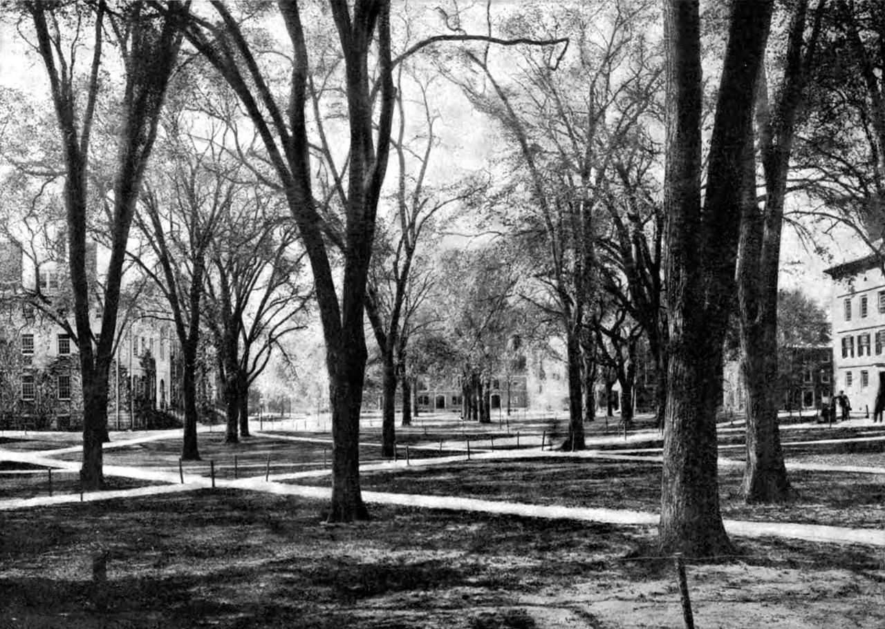
Study Cases/critical thinkers
3rd Method :
Harvard University was the first to apply this teaching method in a decade
of 1920
• Differentiation in Case Studies
Small Vs. Large
Really Vs. Fantastic examples
Subject of analysis: Person Vs. Groups of people
“This is what the case method does—it puts students straight into the game, and ensures they acquire not just skills and abstract knowledge, but also a solid understanding of the outside world.” (Yannis Normand 2017)

Slide 4
Thank You

