Slide 1
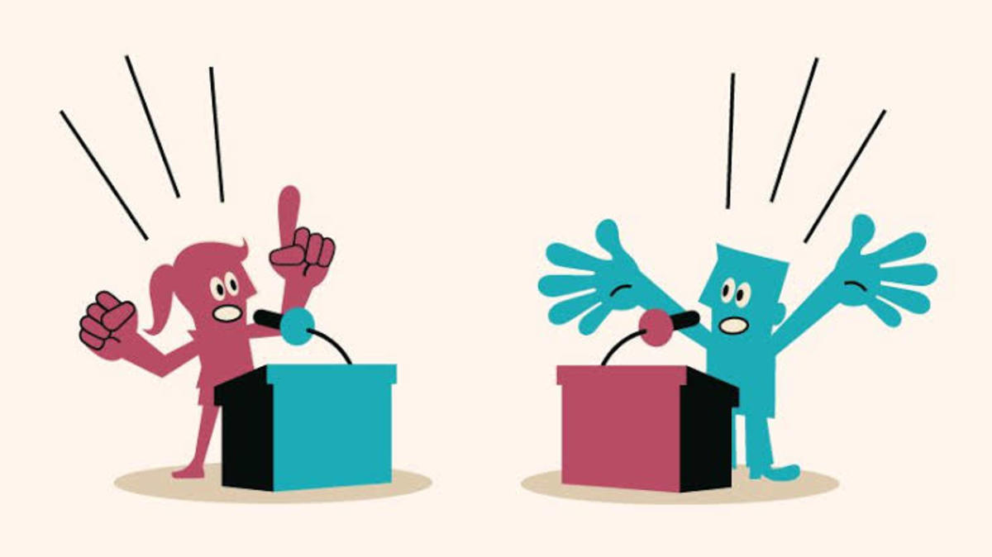

Slide 2
Debate/critical thinkers
Five logical fallacies often used in political and policy debate that are to be avoided:

Slide 3
Debate/critical thinkers
(1) Red Herring Fallacy
Also known as: misdirection, smokescreen, clouding the issue, beside the point, and the Chewbacca defense.
A Red Herring argument is one that changes the subject, distracting the audience from the real issue to focus on something else where the speaker feels more comfortable and confident.
(2) Strawman Fallacy
Also known in the U.K. as Aunt Sally.
A Strawman argument is an intentional misrepresentation of an opponent’s position. It sets up an easy (and false) target for the speaker to knock down.

Slide 4
Debate/critical thinkers
(3) Slippery Slope Fallacy
Also known as absurd extrapolation, thin edge of the wedge, and camel’s nose under the tent.
A Slippery Slope argument is a version of a Red Herring. Specifically, this is a claim that a policy which takes a small step in one direction will lead to a chain of events that will result in drastic change.
(4) Begging the Question Fallacy
Also known as: assuming the initial point, chicken and the egg, and circular reasoning.
In an argument Begging the Question, the conclusion is assumed in one of the argument’s premises, and that premise is not supported by independent evidence. Often called circular reasoning, it begins and ends at the same place.

Slide 5
Debate/critical thinkers
(5) Post Hoc Fallacy
From the Latin phrase “post hoc, ergo propter hoc,” which means “after this, therefore because of this.” Also known as false cause.
Fallacy occurs when an argument is made using illogical reasoning. Post hoc is a fallacy where one reasons that since an event occurred before another, then the first event caused the other. This is not always the case.
Choose the correct fallacy! QUIZ!!

Slide 6
Debate/critical thinkers
A Critical Thinker is able to:
· Ask vital questions and problems, formulating them clearly and precisely
· Collect and assesses vital information, using abstract ideas to interpret it effectively
· Develop well-reasoned and tested conclusions
· Be openminded about alternative points of view
· Can recognize and assess assumptions, implications, and appropriate consequences
· Able to communicate effectively with others
· Able to avoid fallacies of critical thinking – thinking deeply by analyzing the situation

Slide 7
Thank You

