Slide 1
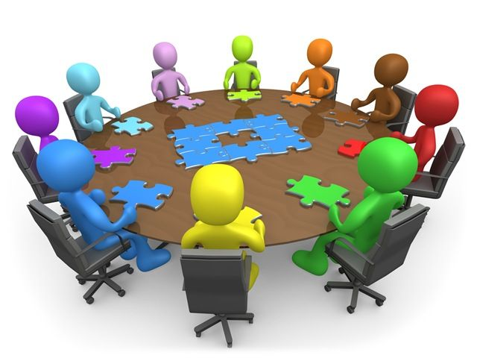

Slide 2
Debate/critical thinkers
1st Method :
Students read and analyze
Students will be placed in small groups of 4 to five students to read and analyze :
There should be children and teenagers in government
Do you think children and adults have different opinions on things?
Is it important that politicians represent every different view point? Why do you think this is?
What issues affect children more than adults?
Is it enough if politicians are parents? Can they speak for their children?
Do children and teenagers have enough experience and maturity to be in government?
Do adults understand what children want and need?
How would it affect a child’s life to be a politician?

Slide 3
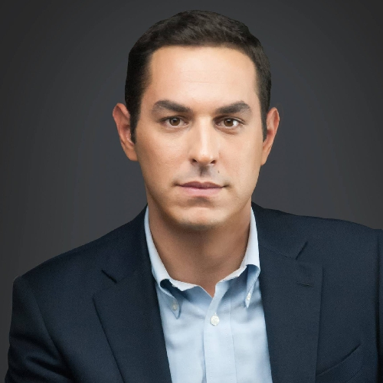
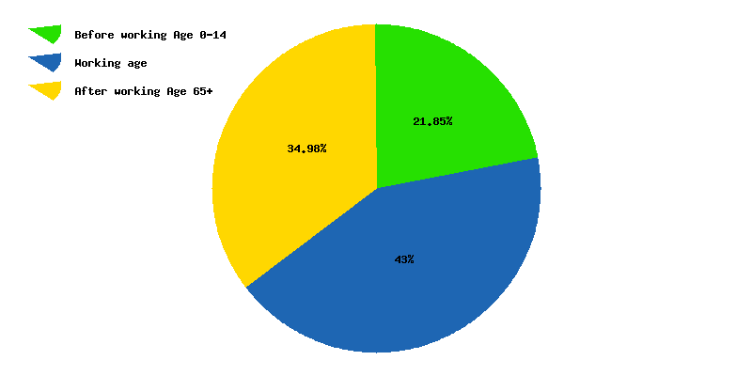
Debate/critical thinkers
1st Method :
FACT: Evangelos Liakos is only 29 years old. He is the youngest member of the Greek parliament ever elected.
FACT: Under-18s make up roughly 1/5 of the greek population

Slide 4
Thank You

