Slide 1
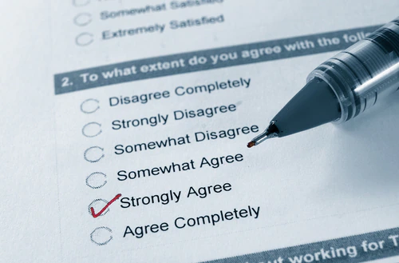
I will select five to six students randomly from class to conduct a one-on-one interview to document the students’ perceptions about the debate. I will ask questions about how the students prepared for the debate and how was their overall experience during the debate.

Slide 2
Debate/critical thinkers
1st Method :
STUDENT PERCEPTION SURVEY
As a result of critical thinking instruction and debating, please answer the following questions using self-assessment using:
Strongly agree Agree Strongly disagree Disagree
1- I am able to formulate the problem clearly and precisely.
2- I am able to ask vital questions to help gather more information.
3- I am able to have well-developed reasoning
4- I am able to maintain a good level of openmindedness
5- I am able to recognize and assess assumptions
6- I am able to identify most possible implications
7- I am able to communicate more effectively
8- I am able to evaluate data to make informative decisions
9- Overall, debating helped me increase my critical thinking

Slide 3
Thank You

