Slide 2
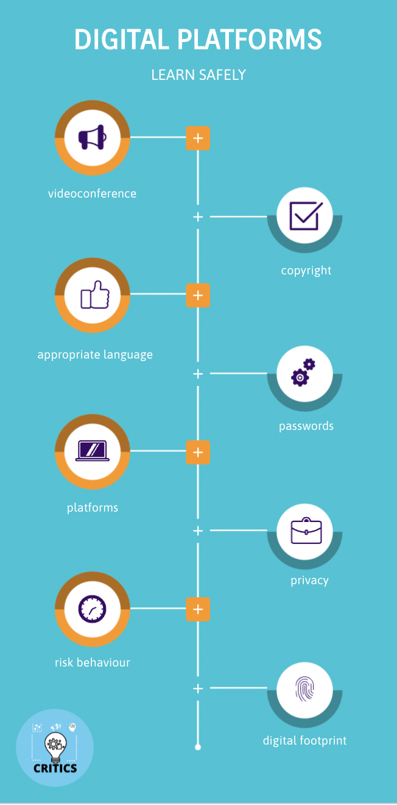
Data Protection
&
Safe Internet
https://view.genial.ly/626439232410a0001823f553/interactive-content-critics-digital-platforms

Slide 3
Thank You

