Slide 1
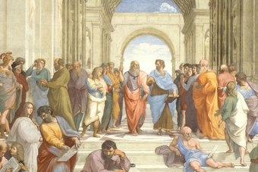

Slide 2
Debate/critical thinkers
1st Method :
Content:
Think-Pair-Share Activity
Critical thinking defined
Fallacies of critical thinking
Students read and analyze
Student perception study
Student interview questions

Slide 3
Thank You

