Slide 2
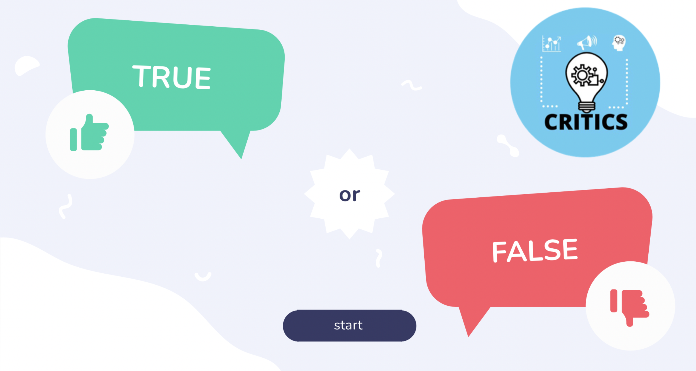
Desinformation / Fake News
Game: Fake News
https://view.genial.ly/62530d80e82ee20010b63f73/interactive-content-true-or-false

Slide 3
Thank You

